Slide 1
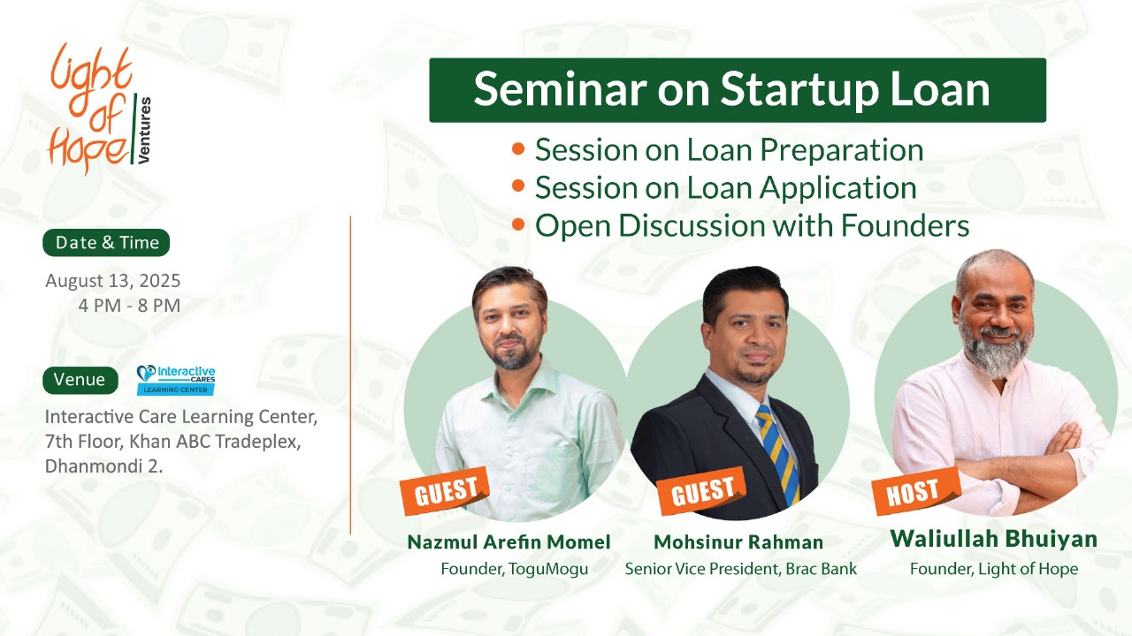

Slide 2

Seminar Outline
Time | Seminar Agenda/Topic
4:00 – 4:15 PM | Registration
4:15 – 4:30 PM | Welcome Speech and Setting Agenda
4:30 – 5:00 PM | Presentation on Startup Loan Preparation Speaker: Dr. Nazmul Arefin
5:00 – 5:45 PM | Presentation on Startup Loan & Investment Speaker: Mohsinur Rahman
5:45 – 7:00 PM | Open Discussion & Q/A with Founders Guest: Mohsinur Rahman Host: Waliullah Bhuiyan
7:00 – 7:30 PM | Support from Light of Hope Ventures Speaker: Waliullah Bhuiyan
7:30 – 8:00 PM | Open Networking

Slide 3
Who is in the Room Today?
We have invited 104 Founders for the Seminar.
Sector Specific Business | Number
Education & Skills | 8
Health-tech/Health | 4
Agro/Agriculture | 10
E-Commerce | 8
Manufacturing | 7
Tech, SaaS, Software | 28
Service | 22
Others | 10

Slide 4
Size of Business
(based on Annual Turn-over)
Annual Turn-over Range (BDT) | Number of Business
50 Crore+ | 2
25-50 Crore | 7
10-25 Crore | 28
1-10 Crore | 22
Under 1 Crore | 38

Slide 5
Total Power of You All Combined
Business/Startup Achievement | Numbers
Total Annual Turn-over | 520.8 Crore Taka
Total Direct Employment | 2300+ People
Avg. Business Age | 3.14 Years

Slide 6


Supporting SME & Startups
with Mentorship and Financial Matchmaking
for Sustainable Business Growth.

Slide 7
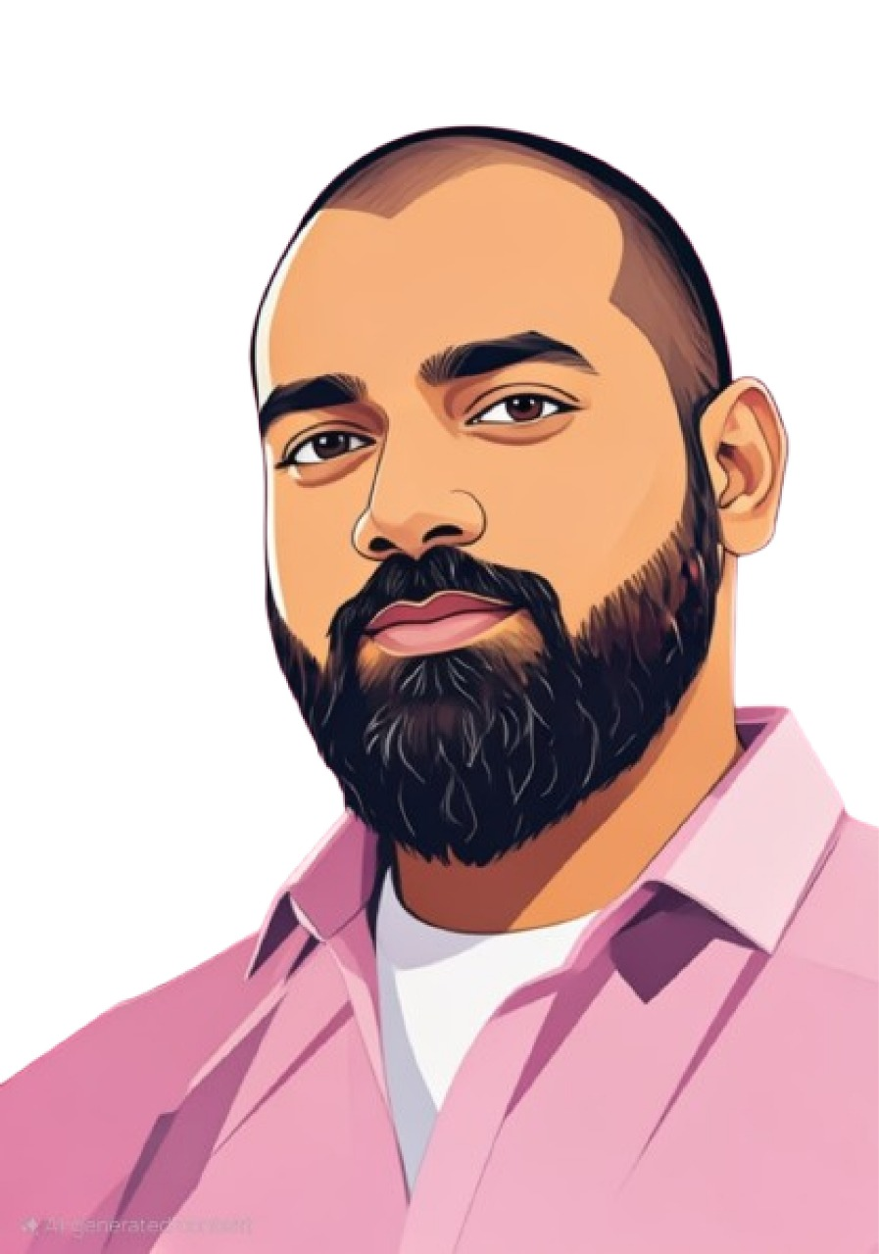











Founded by Waliullah Bhuiyan
Purpose-Driven Serial Entrepreneur | Mentor for Founders | Thought Leader on Education, Entrepreneurship & Social Innovation | Building Impact Ventures |
Founder & Chairman
Ex-Manager
Founding Director
Education & Training
Co-Founder
Islamic University of Technology (IUT)
Mirzapur Cadet College (MCC)
15+ Years Experience working in Education & Skills, Tech, Renewable Energy, Climate Change, Employment sectors.
National SME Award Winner 2023 as the Best Entrepreneur.

Slide 8




The CRISIS
2008-2024
Financing Gap
Bangladesh’s Job Creation Engine becomes a graveyard of broken potential.
$2.8 Billion SME Credit gap despite
Lower NPL (5.2% vs corps’ 18.7%)
Distorted Growth
Youth Unemployment
Large corps grew 300% while
SMEs stagnated.
2.1 Million jobs lost.
Notes:
S Alam 20 billion dollar scam.

Slide 9
GDP Contribution of SMEs
Country/Region | GDP Contribution
OECD Countries | 55-60%
Japan | 50%
China | 60%
Vietnam | 45%
Pakistan | 40%
India | 37%
Bangladesh | 32%

Slide 10
Why SMEs are Bangladesh’s Job Engine?
SME
Large
Job Creation
87% of Workforce
13% of Workforce
NPL Rate (2024)
5.2%
18.7%
Policy Support
12% of Loans
88% of Loans

Slide 11
What is Left for SMEs and Startups in Bangladesh?
1.2% Bank Accounts hold 75% Bank Loan.
78% Loans are only distributed between Dhaka and Ctg.
All 62 Districts combined, getting only 22% of the loans.
64% Deposit comes from Dhaka and Ctg.
How a Startup Founder from Shylet or
a SME Founder from Rajshahi will ever complete?

Slide 12
Why We Started?
Supporting SMEs & Startups to become Large-size Companies to
create more employment, especially among Youth in Bangladesh.
Helping SMEs and Startups to reduce $2.8 Billion Financing Gap to facilitate business growth.

Slide 14
Supporting SME & Startups
with Mentorship and Financial Matchmaking
for Sustainable Business Growth.

Slide 15
Our Focused Sectors
We are sector agnostic. We are focusing on Sectors that creates more employment, earn foreign currency, and offers strategic value for the country’s overall economic growth. Innovative and high-growth sustainable businesses are given priority.
Agriculture
& Agro-tech
Education & Skill Development
Tech, SaaS, Software
E-Commerce
Service Sector
Manufacturing
Health & Wellbeing
Emerging Sector

Slide 16
Who is our Ideal Founder?
The founder/s and business should meet most criteria to join the program.
Full time founder/s
Doing business for minimum 2-3 years
Has a Team of minimum 8-10 people
Annual Revenue is minimum 50 lakh+
Export-oriented or product that replaces import will given priority

Slide 17
Our Supports for Founders
No proper business growth program available for Founders that offers one-to-one mentorship and access to capital for business growth. We found the Founders are asking for these 3 Supports:
Support 1
Support 2
Support 3
DIrect Financial Matchmaking
Guidance & Mentorship for Business Growth
Customized Business Growth Services
Connecting SMEs, Startups with Financers & investors to unlock funding and capital opportunities for Business Growth.
We are offering 3-month mentorship program, run and mentored by successful founders, to help business growth.
Personalized coaching and 1-on-1 support tailored to help founders grow their business effectively.

Slide 18



Investment & Financing Matchmaking
Founders will get access to necessary financing from our partners for their business growth.
Up to 10 lakh equity investment & Access to capital for business growth.
Necessary support for international expansion.
Knowledge sharing for Shariah-approved financing.
Access to halal financing for business growth.
Financing to agro-based businesses.

Slide 19
Potential Banking and Financial Institution Partners
We are in discussion with Banks, NBFIs to explore special loan products, SME loans, Startup loans to offer flexible and low-cost financing options for founders.
We are also exploring other collaboration opportunities to support SME business and startups.
Startup Loan
Work order Financing
Sustainable Financing
SME Foundation Financing from Banks
SME Loan without Collateral
Women Entrepreneur Loan

Slide 20
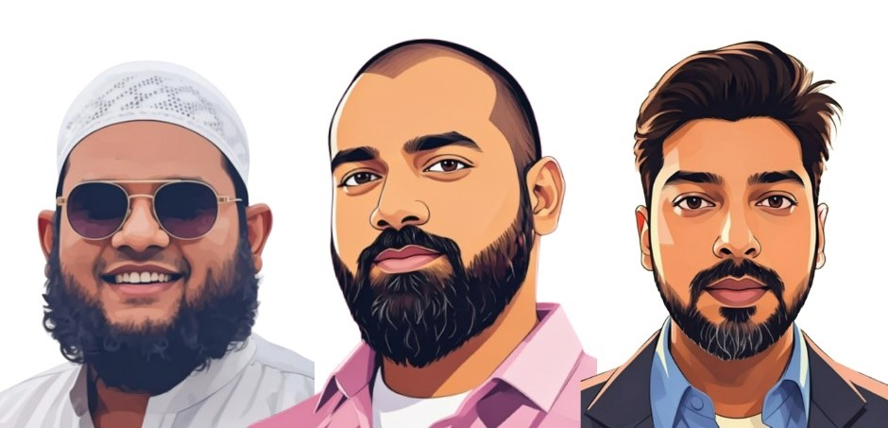
Mentorship Program
During 3-month Mentorship program, the Founders will get direct one-to-one and group mentorship from the most successful founders and entrepreneurs from relevant industries.
They will pitch their business to investor and financer also after graduating.

Slide 21






3-Month Mentorship Program
📆 Program Duration: 3 months
🧩 Total Sessions: 6 thematic sessions +
optional 1-on-1 mentoring
🕘 Session Timing: Every 2 weeks, 9:00 PM – 11:00 PM
🙋 1-on-1 Mentorship
Customized guidance from Sector Specific expert mentors
Schedule upon request (notify before)
Core Topics (12 Classes)
Business Growth Foundations
Customer Acquisition & Retention
Branding & Marketing Essentials
Revenue Model & Financial Planning
Operations & Process Design
Pitching & Investment Readiness

Slide 22
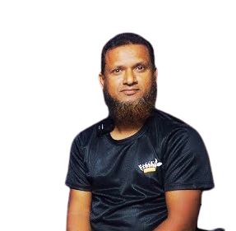
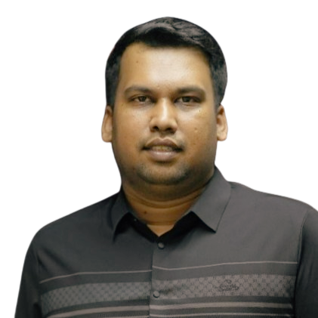
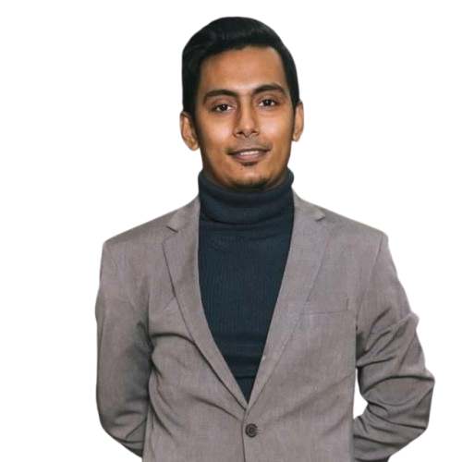



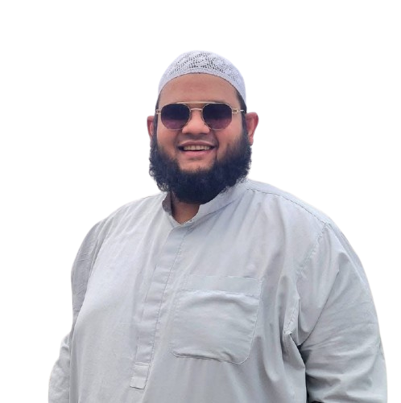
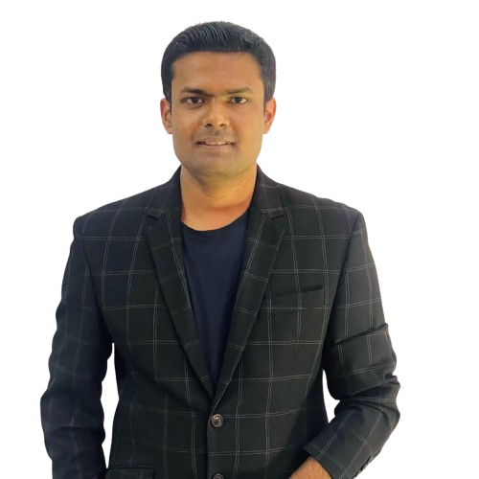





Industry Specific Mentors
Founders will get direct one-to-one and group mentorship from the most successful founders and entrepreneurs from relevant industries.
Agro & Agritech
Diptha Saha
Mahmud Rahman
Mujahidul (Jahid) Islam
Co-founder & COO, Agroshift
Co-founder, WeGro
Founder, FresieFarm
E-Commerce
Omer Sharif Ibney Hai
Morin Talukder
Founder, Next Leaders
Co-Founder & CEO, Pickaboo

Slide 23

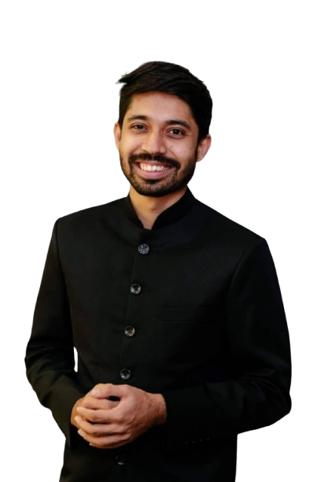
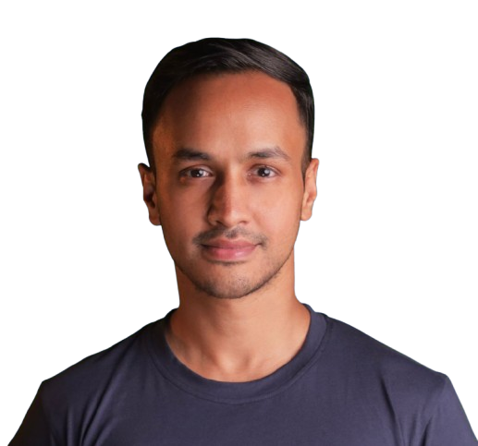


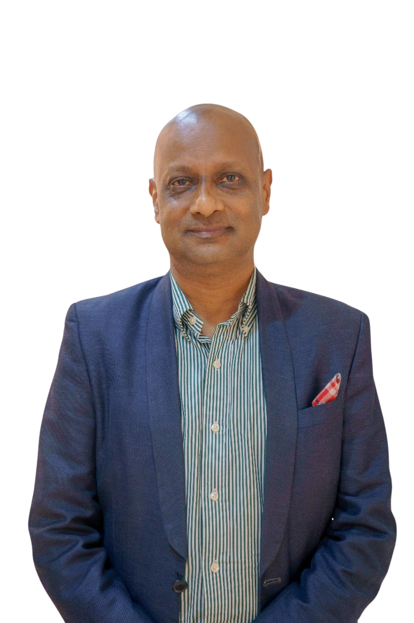
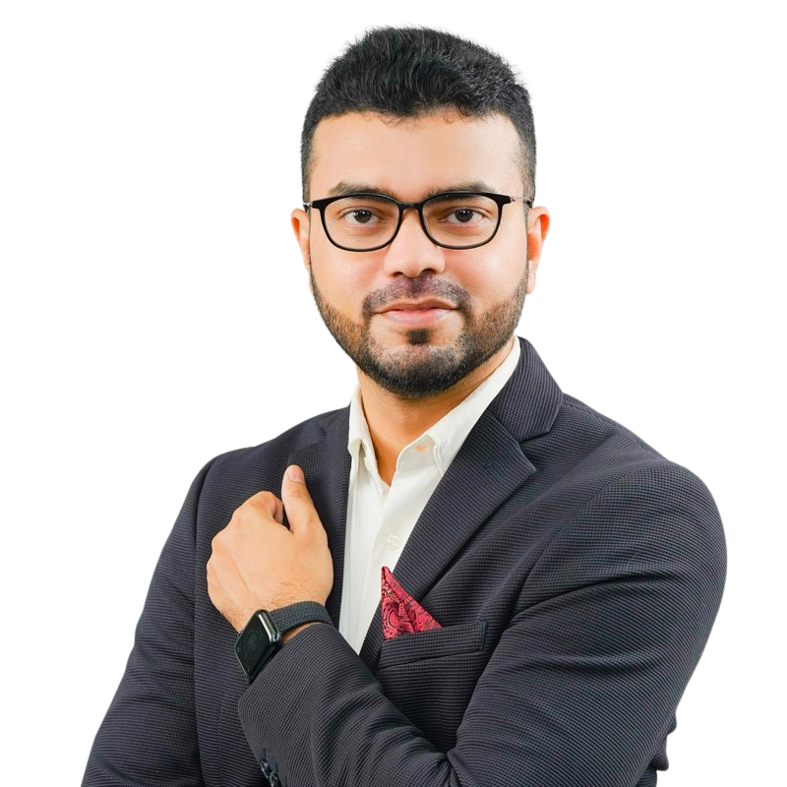




Industry Specific Mentors
Industry Specific Mentors
Education, Skills & EdTech
Ishmam Chowdhury
Shahir Chowdhury
Ayman Sadiq
Chief Operating Officer, Shikho
Founder & CEO, Shikho
CEO, 10 Minute School
Tech, SaaS, Software
M Asif Rahman
M Majur Mahmud
Serial Tech Founder, WPDeveloper, Startise, xCloud
President, Datasoft System

Slide 24



Support for Business Growth
Founders will get access to necessary growth support for customer acquisition, marketing support and alternative financing from our selected partners.
For revenue growth and customer acquisition.
Get Access to 150 Million Customers & 500+ Businesses.
Content Marketing, Branding and Digital Promotion support.
Connecting development funds, Business Model, Investment Readiness Support

Slide 25



Our Activities
Regularly organizing free seminars, workshops and online webinars on various topics relevant for the founders for their business growth.
Successful founders, industry leaders are taking these sessions.

Slide 26
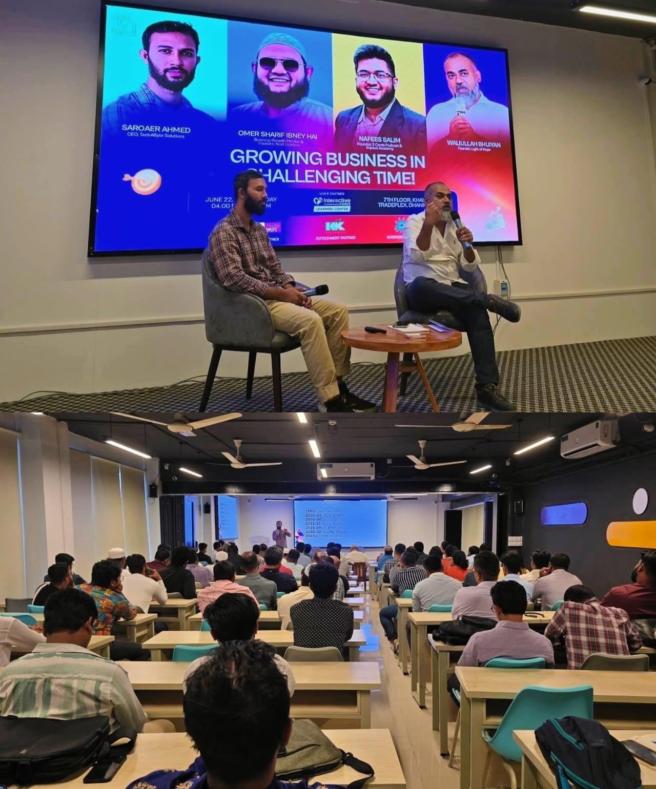
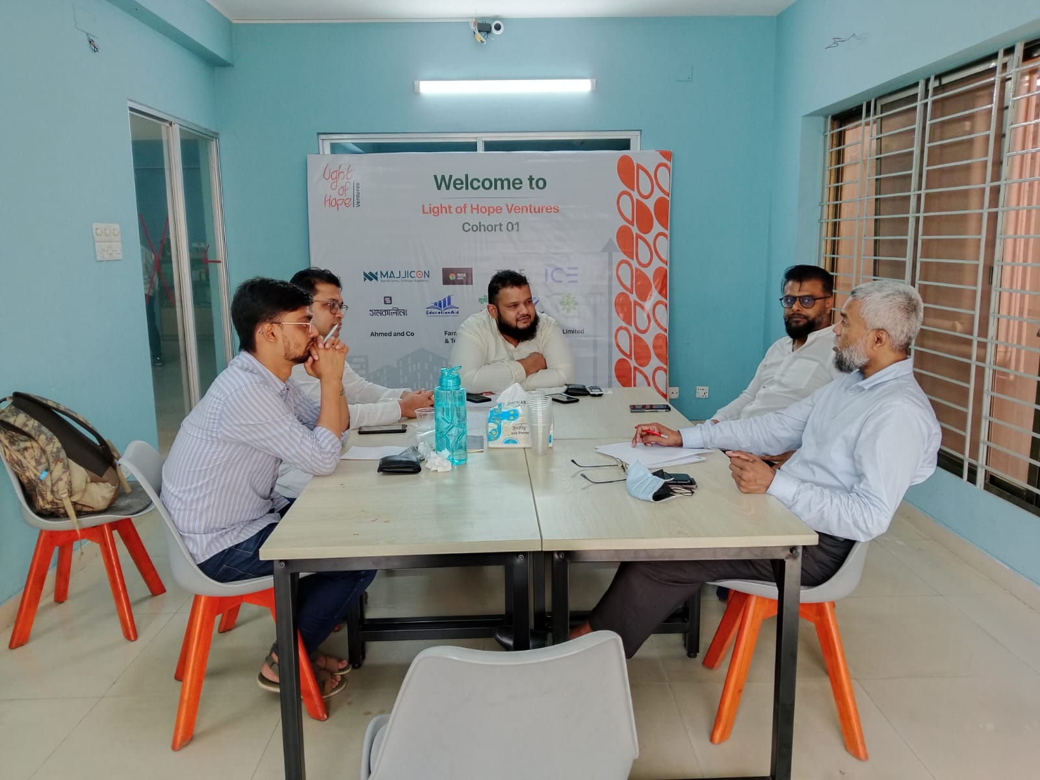
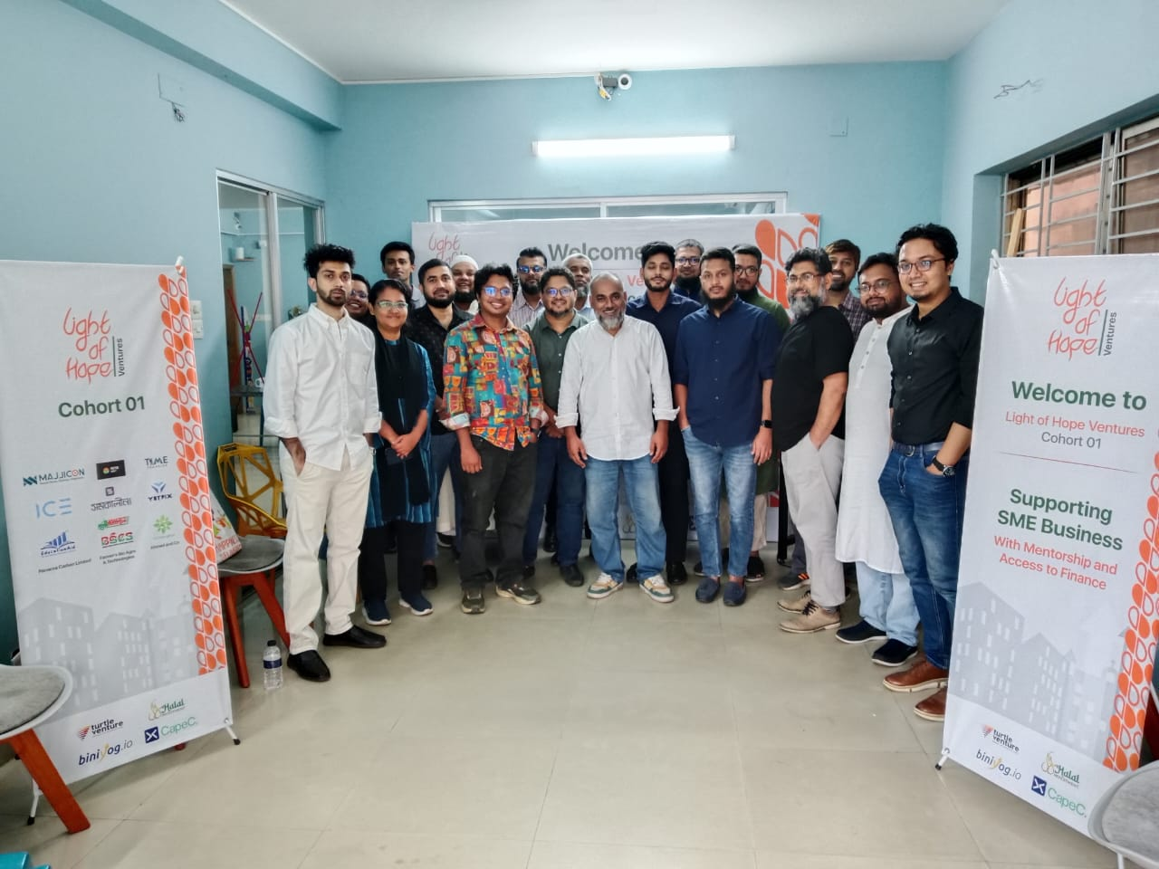
Our Activities
Our Activities

Slide 27









Cohort 1 Businesses
Cohort 1 Businesses
List of our Cohort 1 businesses whom we are directly mentoring and providing Access to Finance.

Slide 28

Supporting Businesses
with Mentorship and Financial Matchmaking
Cohort 2 is Starting
Apply Now

Slide 29
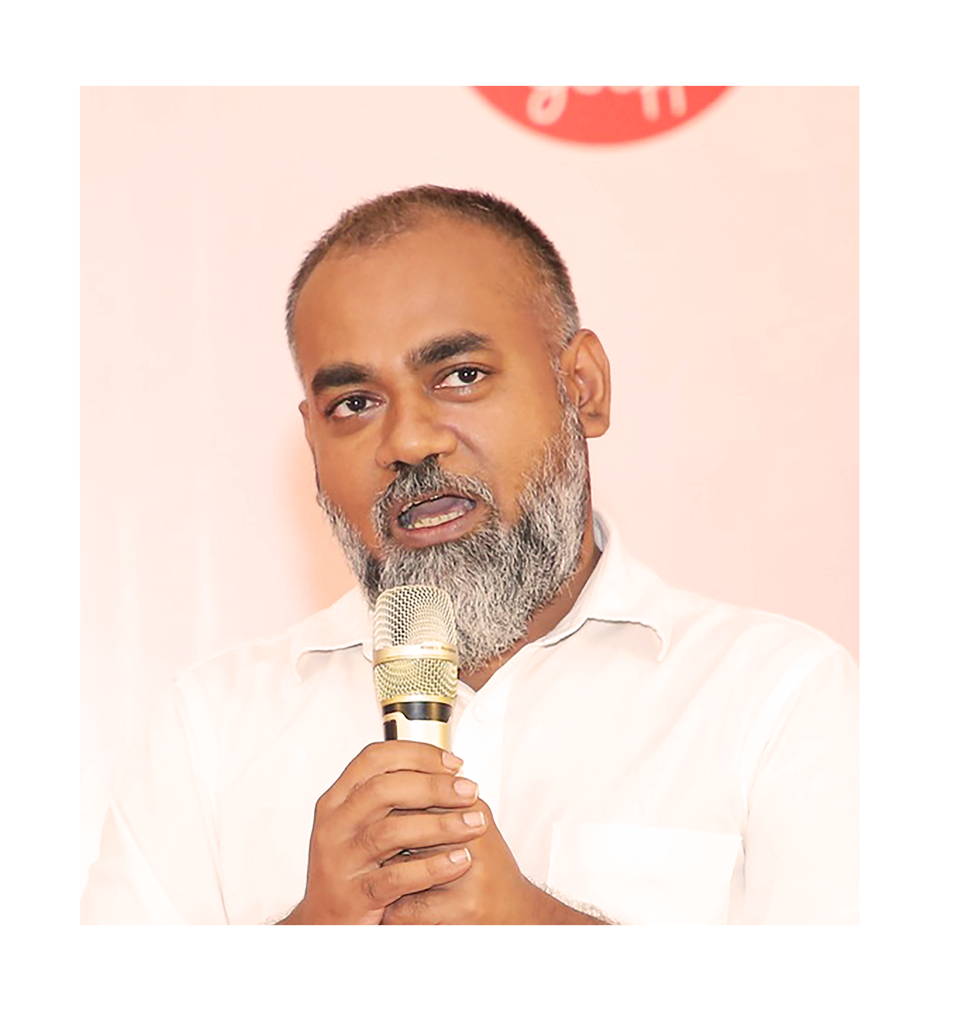
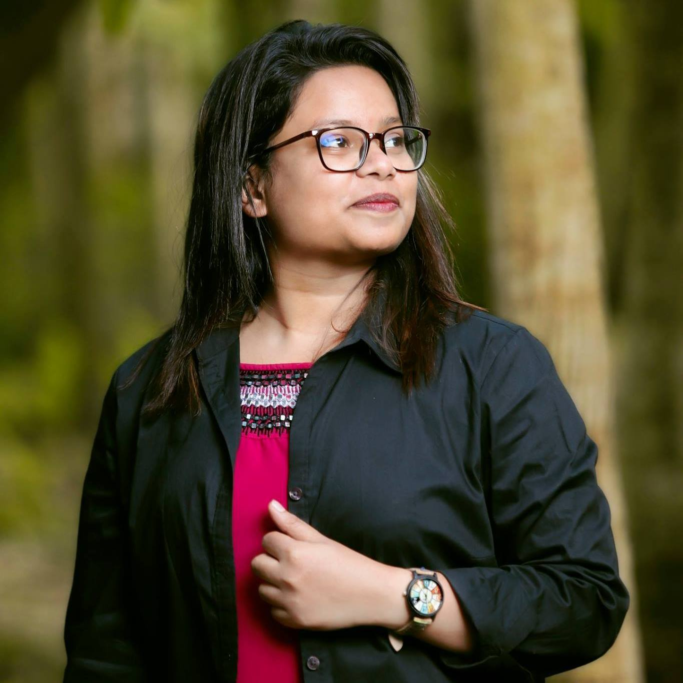
Contact for Collaboration
Waliullah Bhuiyan
Founder & CEO
Light of Hope Ltd.
Mob: +8801777-800866
Email: wali@lohbd.com
Noshin Sharmilee
Program Manager
Light of Hope Ventures
Mob: +8801796-905427
Email: sharmilee0113@gmail.com
Office Address: Light of Hope Ltd., Regina Garden, House 67/A, Road 9/A, Dhanmondi 1209, Dhaka, Bangladesh.

